Slide 1
Northern Hammer*
Hardware Retailers
Churn analysis
Making customers subscribe to our DIY Channel again
Johan Pelssers
Codecademy
September 29th, 2025
Data Analyst
Data Analysis Bootcamp Project Assignment 1a - Churn Analysis
*Fictional Company & Data Any resemblance to actual persons, places, or events is purely coincidental.

Slide 2
NORTHERN HAMMER | CHURN ANALYSIS - MAKING CUSTOMERS SUBSCRIBE TO OUR DIY CHANNEL AGAIN
01
Internet Service
Streaming TV
Streaming Movies
26.5% Churn
who unsubscribes from our channel?
Monthly Subscription Charges
Total Subscription Charges
Payment Method
Senior Citizen
Partner
Gender

Slide 3
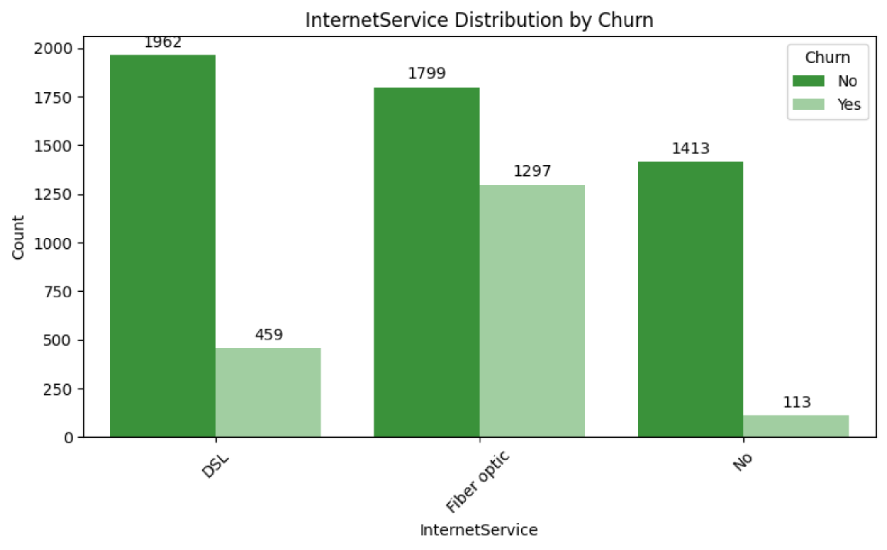
NORTHERN HAMMER | CHURN ANALYSIS - MAKING CUSTOMERS SUBSCRIBE TO OUR DIY CHANNEL AGAIN
02
Internet Service
Fiber optic users churn from subscribing to our channel
41.9%
FIBER OPTIC INTERNET USERS CHURN
15.4% MORE THAN AVERAGE
19%
DSL INTERNET USERS CHURN
7.4%
NO INTERNET USERS CHURN

Slide 4
NORTHERN HAMMER | CHURN ANALYSIS - MAKING CUSTOMERS SUBSCRIBE TO OUR DIY CHANNEL AGAIN
03
TV Streaming
Both TV streamers and non TV streamers churn just
a little more than average
33.5%
NON STREAMERS CHURN
7% MORE THAN AVERAGE
30.1%
STREAMERS CHURN
3.5% MORE THAN AVERAGE
7.4%
WITHOUT INTERNET SERVICES CHURN

Slide 5
NORTHERN HAMMER | CHURN ANALYSIS - MAKING CUSTOMERS SUBSCRIBE TO OUR DIY CHANNEL AGAIN
04
Movie Streaming
Both movie streamers and non movie streamers churn just
a little more than average
33.6%
NO MOVIE STREAMERS CHURN
7% MORE THAN AVERAGE
30%
STREAMERS CHURN
3.5% MORE THAN AVERAGE
7.4%
WITHOUT INTERNET SERVICES CHURN

Slide 6
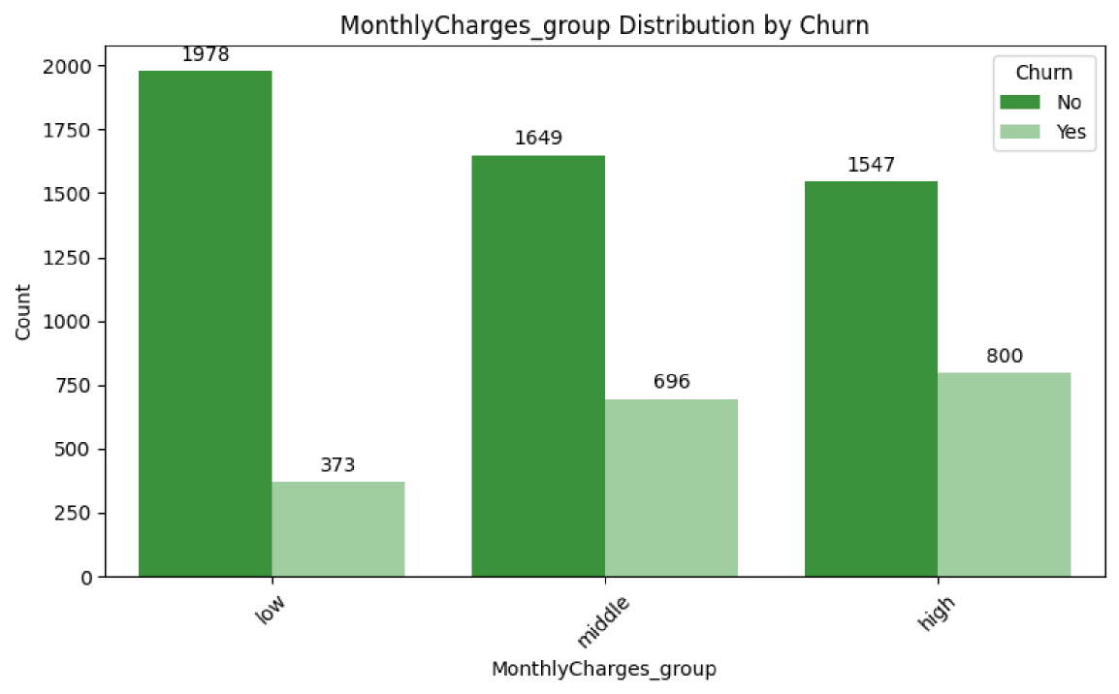

NORTHERN HAMMER | CHURN ANALYSIS - MAKING CUSTOMERS SUBSCRIBE TO OUR DIY CHANNEL AGAIN
05
Monthly Subscription Charges
Payers with higher monthly charges are slightly more likely to churn.
34.1%
WITH HIGH MONTHLY CHARGES CHURN | 7.5% MOVE THAN AVERAGE
29.7%
WITH MODERATE MONTHLY CHARGES CHURN
15.9%
WITH LOW MONTHLY CHARGES CHURN

Slide 7
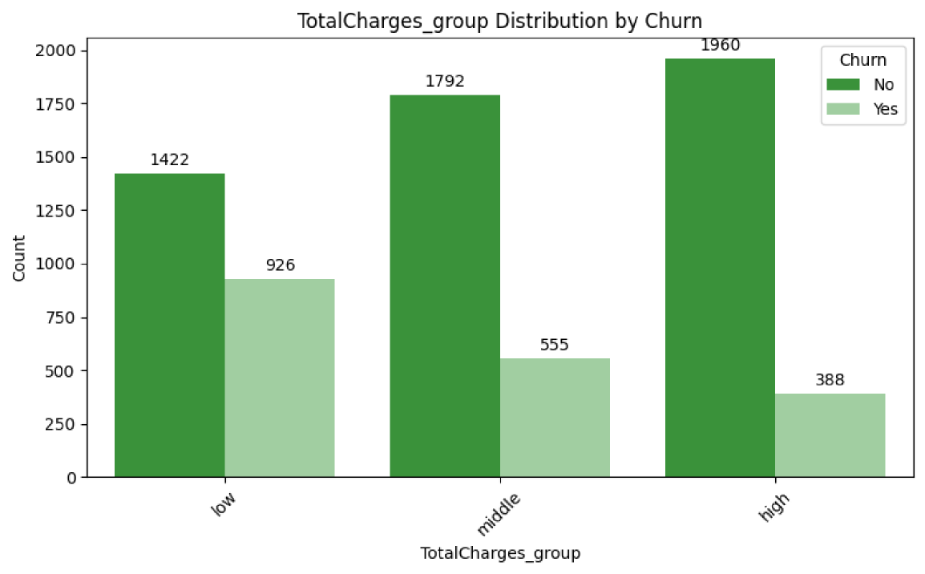
NORTHERN HAMMER | CHURN ANALYSIS - MAKING CUSTOMERS SUBSCRIBE TO OUR DIY CHANNEL AGAIN
06
Total Subscription Charges
Payers with higher total charges are highly more likely to churn.
39.4%
WITH HIGH TOTAL CHARGES CHURN
12.9% MOVE THAN AVERAGE
23.6%
WITH MODERATE TOTAL CHARGES CHURN
16.5%
WITH LOW TOTAL CHARGES CHURN

Slide 8
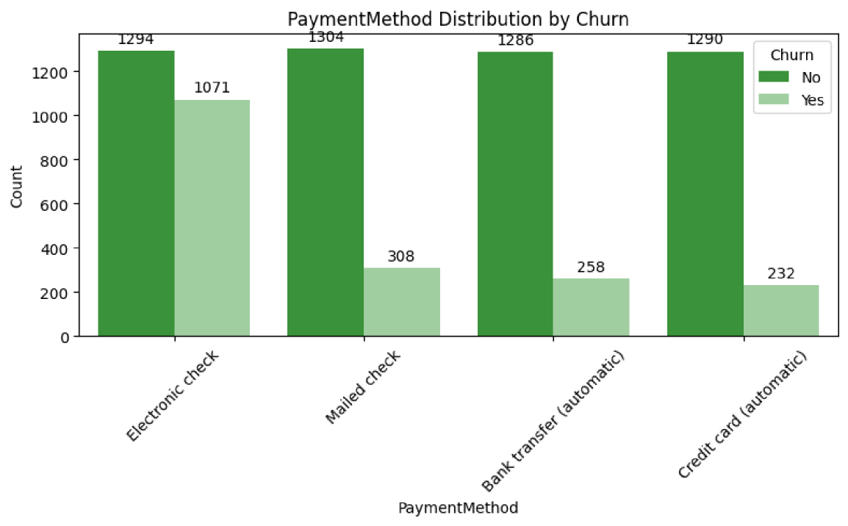
NORTHERN HAMMER | CHURN ANALYSIS - MAKING CUSTOMERS SUBSCRIBE TO OUR DIY CHANNEL AGAIN
07
Payment Method
Payers with electronic check
churn significantly more that those who pay with other methods
45.3%
E-CHECK PAYERS CHURN
18.8% MORE THAN AVERAGE
<20%
AMONG THOSE
THAT USE OTHER PAYMENT METHODS LESS THAN 20% CHURN

Slide 9
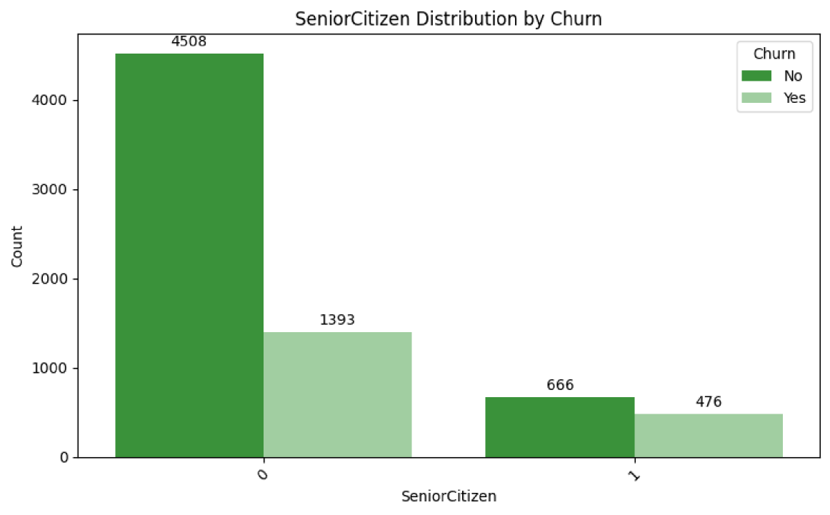
NORTHERN HAMMER | CHURN ANALYSIS - MAKING CUSTOMERS SUBSCRIBE TO OUR DIY CHANNEL AGAIN
08
Senior Citizens
Senior citizens are much more likely to churn
42.7%
SENIOR CITIZENS CHURN
16.2% MORE THAN AVERAGE
23.6%
NON SENIOR CITIZENS CHURN

Slide 10
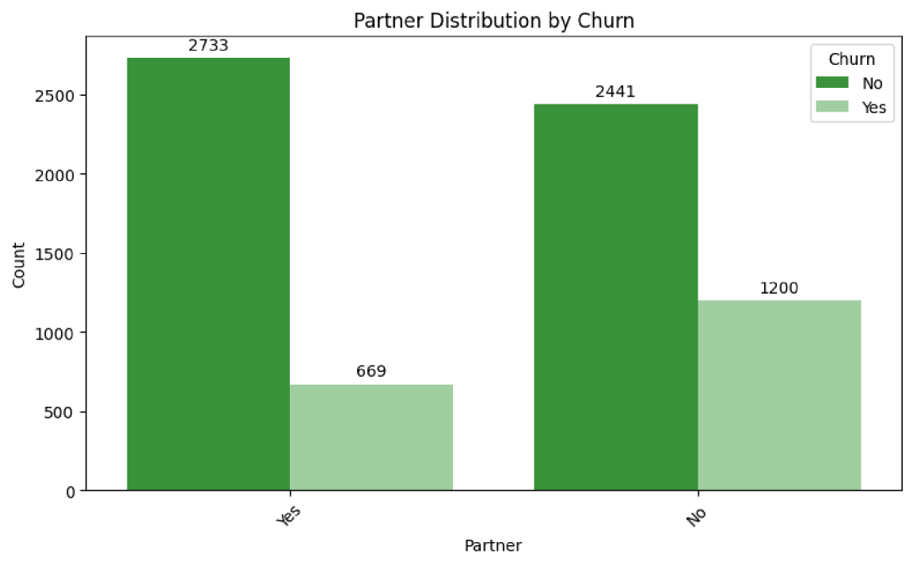
NORTHERN HAMMER | CHURN ANALYSIS - MAKING CUSTOMERS SUBSCRIBE TO OUR DIY CHANNEL AGAIN
09
Partner
Those without partners are slightly more likely to churn
33%
WITHOUT PARTNERS CHURN
6.5% MORE THAN AVERAGE
19.7%
WITH PARTNER CHURN

Slide 11
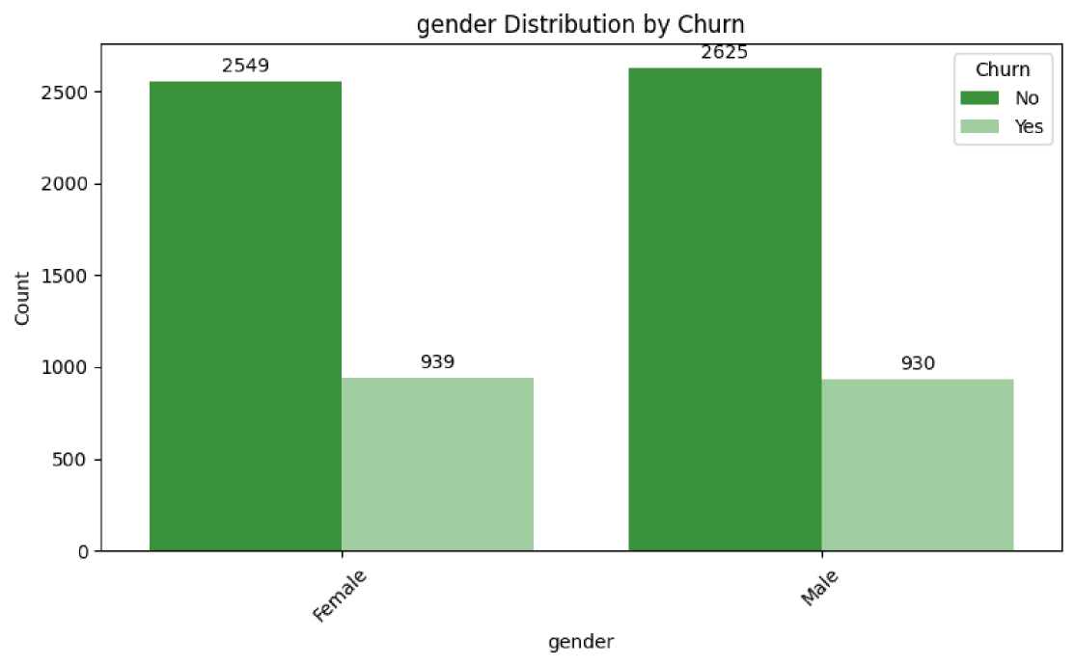
NORTHERN HAMMER | CHURN ANALYSIS - MAKING CUSTOMERS SUBSCRIBE TO OUR DIY CHANNEL AGAIN
10
Gender
Men are not more or less likely to churn than women
26.9%
WOMEN CHURN
26.1%
MEN CHURN

Slide 12
NORTHERN HAMMER | CHURN ANALYSIS - MAKING CUSTOMERS SUBSCRIBE TO OUR DIY CHANNEL AGAIN
11
Key insights
Highly more likely to churn
Senior Citizens E-check Payers Optic Fiber Internet High Total Charges
Slightly more likely to churn
Internet users, both streamers and not streamers High Monthly Charges No partner
No differences in churn between genders

